Slide 1

DES211 Final Project
Professor : Dr Vikas Kumar
Faculty mentor : Dr Venkatnaryan Hariharan
Team mates :
Kartheek Kotha
A Pavan Kumar
Ramakrishna Naidu Bhupathi
Mir Ahmed
P.S. Arun Mihir

Slide 2

Problem Statement
Shiv Nadar University is a sprawling campus of 286 acres. Although the academic Blocks are located nearby, there are difficulties while going to and coming from the Towers, Indoor sports complex, and Dining halls in harsh seasons like heavy rains and hot summers. Similar Problems are faced in other Places also. So, we need to design a commuting device that is portable and reduces the chances of mishandling and minimizes the maintenance

Slide 3

Advantages of Cycling
Bicycles are eco-friendly
They saves you money
Biking saves time
Cycling is good for your mental health
Cycling exercises your body

Slide 4
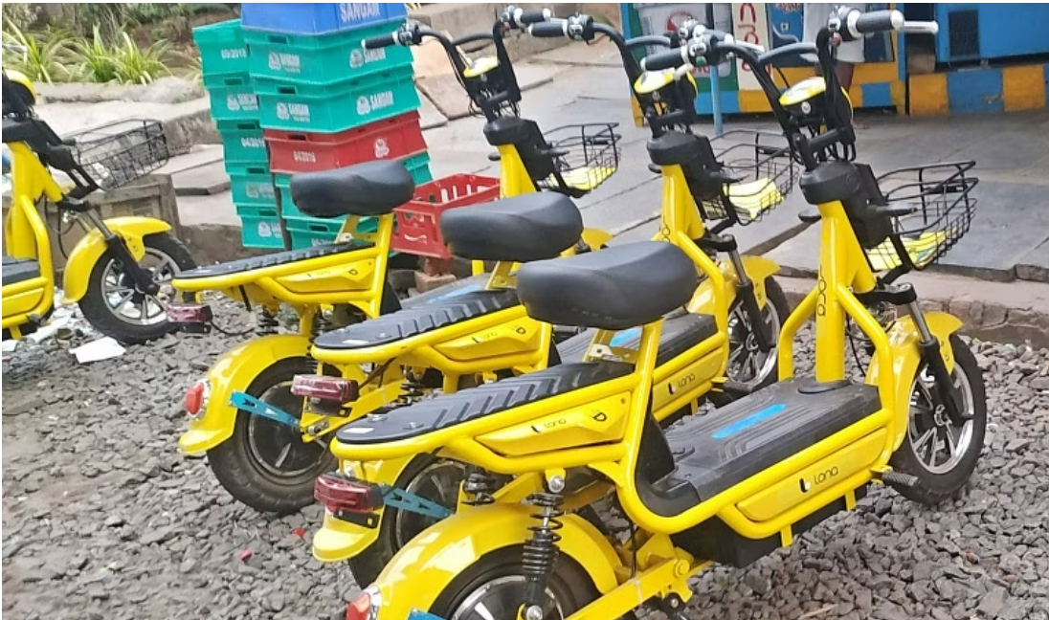
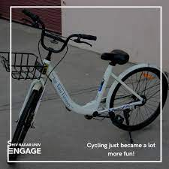
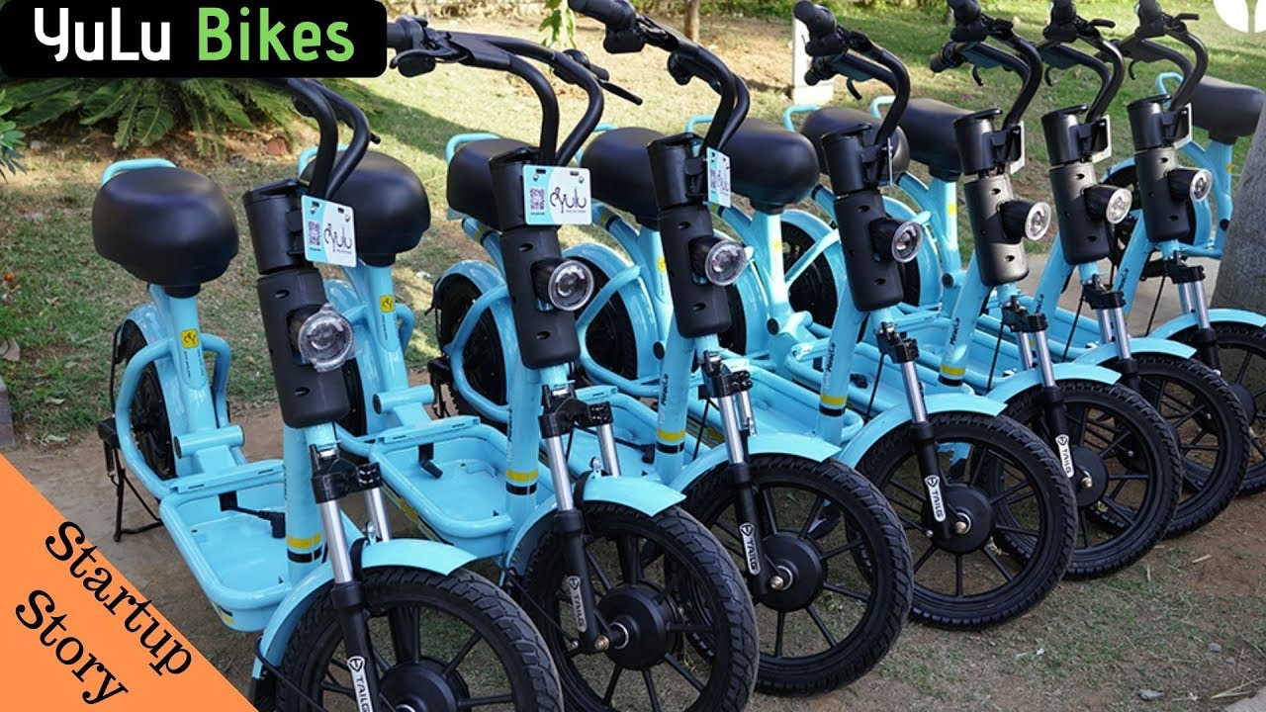
Existing cycle systems
YULU Cycle System
--Bengaluru
Bounce and Lona rental systems
--Andhra Pradesh
SNIoE Cycle System
--SNIoE

Slide 5

Problems in existing designs
Due to a lack of frequent maintenance (Lack of air in the tubes and oiling), users face problems while using them
Mishandling of the cycles done by a few people decreases the availability of the cycles
We can't use them in bad weather conditions, mainly when it is raining and too sunny
There is no automation in the cycles. When people are too tired, they feel like not to cycle
No proper luggage handlers are provided in the present cycle systems
Water Bottle holders are not available for the many cycles
No lights are provided, which causes the problem to travel at night

Slide 6

Our Problem Statement is to design a bicycle that have the below features
Can be used in rainy seasons
Decrease the chance of mishandling
Can be manufactured at low cost
Cycles that reduce the maintenance or frequent checks
Cycle that includes good balance and comfort
Cycles that are motorized with non-fuel
Define Phase

Slide 7
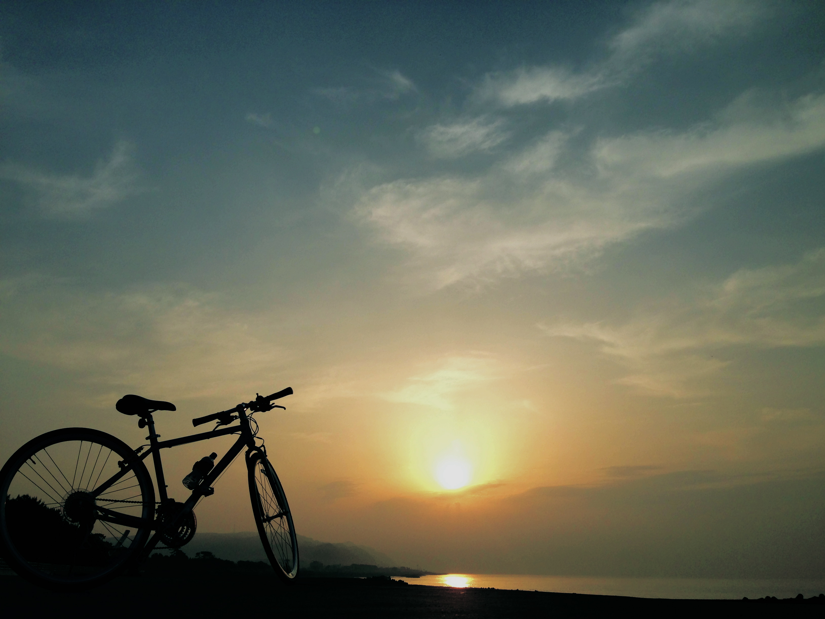
Ideation Phase
Design Ideas we got
1) Cycle that works on electromagnetic Induction and solar sheets
2) Cycle that works on solar panels and Electric Motors.
3) Cycle that works on water engine.
4) Portable bike that works on electricity.
5) Cycle with portable motor that works on electric Power.

Slide 8
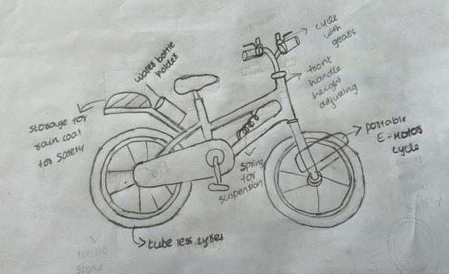
Idea Five
Problems we managed to solve :
Can withstand in the harsh weather conditions
The motor is Portable
The cycle is motorized
Very less chance of mishandling
The cycle is comfortable to use
Cycle can be used at nights
Can be manufactured at low cost
Has a water bottle holder

Slide 9
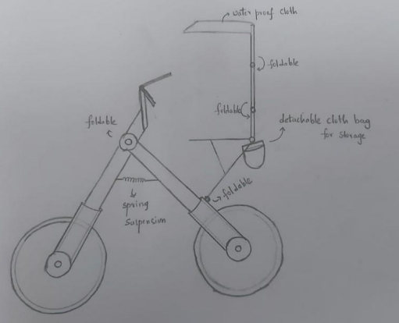
Idea Four
Problems we managed to solve :
Can withstand in the harsh weather conditions
The bike is Portable
The bike runs on electricity
The bike is motorized
Very less chance of mishandling
Can be manufactured at low cost
Has a storage facility

Slide 10
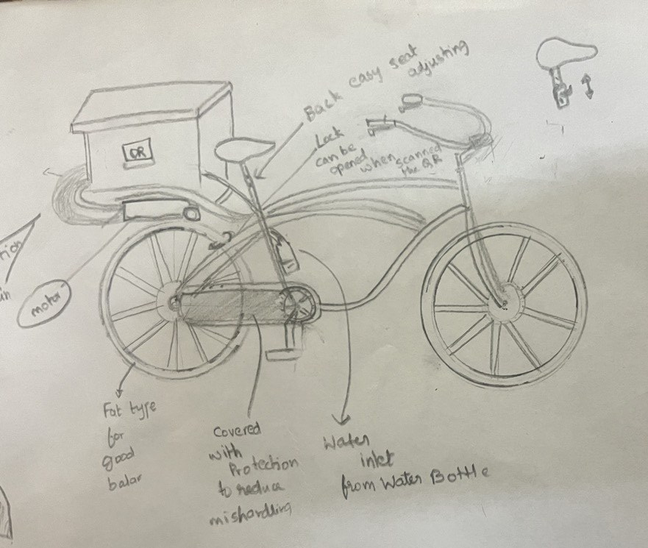
Idea Three
Problems we managed to solve :
Can withstand in the harsh weather conditions
The motor is portable
The cycle runs on water which is eco-friendly
The cycle is motorized
Nearly no chance of mishandling
The cycle is comfort to use
Cycle can be used at nights
Can be manufactured at moderate cost

Slide 11
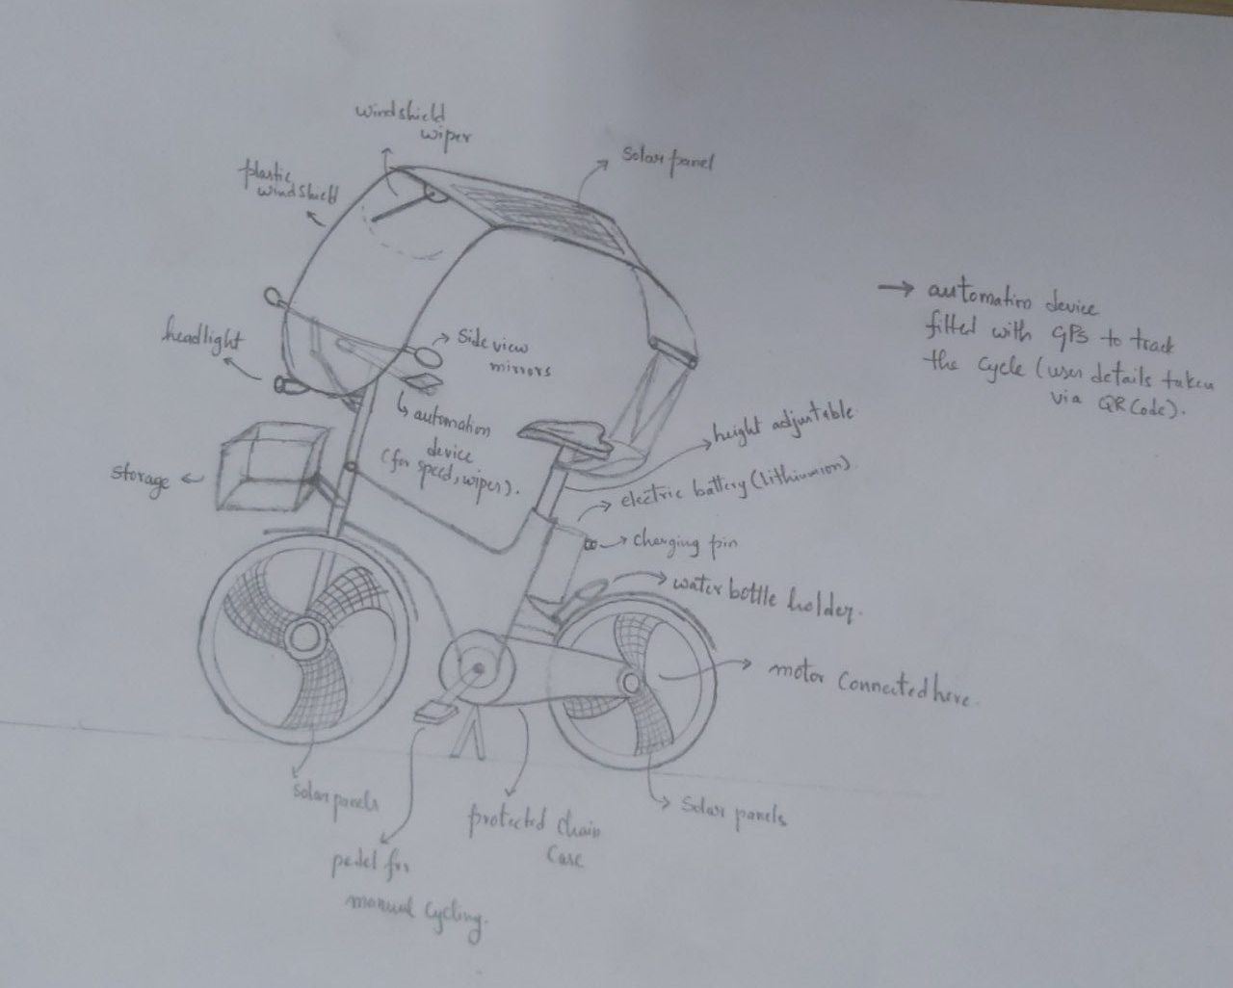
Idea Two
Problems we managed to solve :
Can withstand in the harsh weather conditions
The cycle is motorized
Nearly no chance of mishandling
Storage problem has been solved
The cycle is well-balanced
The cycle is comfort to use
Can be manufactured at moderate cost
Cycle can be used at nights
The cycle runs on electricity

Slide 12
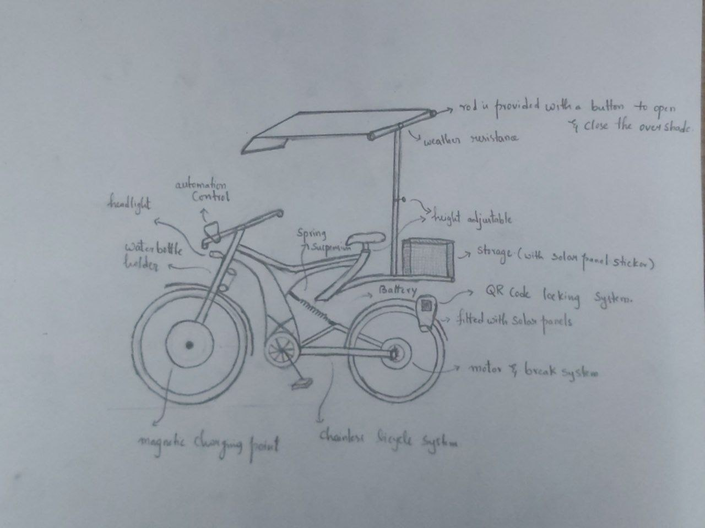
Idea One
Problems we managed to solve :
Can withstand in the harsh weather conditions
The cycle is motorized
Nearly no chance of mishandling
Decreased the work force required for maintenance
The cycle is light-weighted which increases the balance
The cycle is comfort to use
Can be manufactured at moderate cost
Storage problem has been solved
Eco-friendly
Cycle can be used at nights

Slide 13
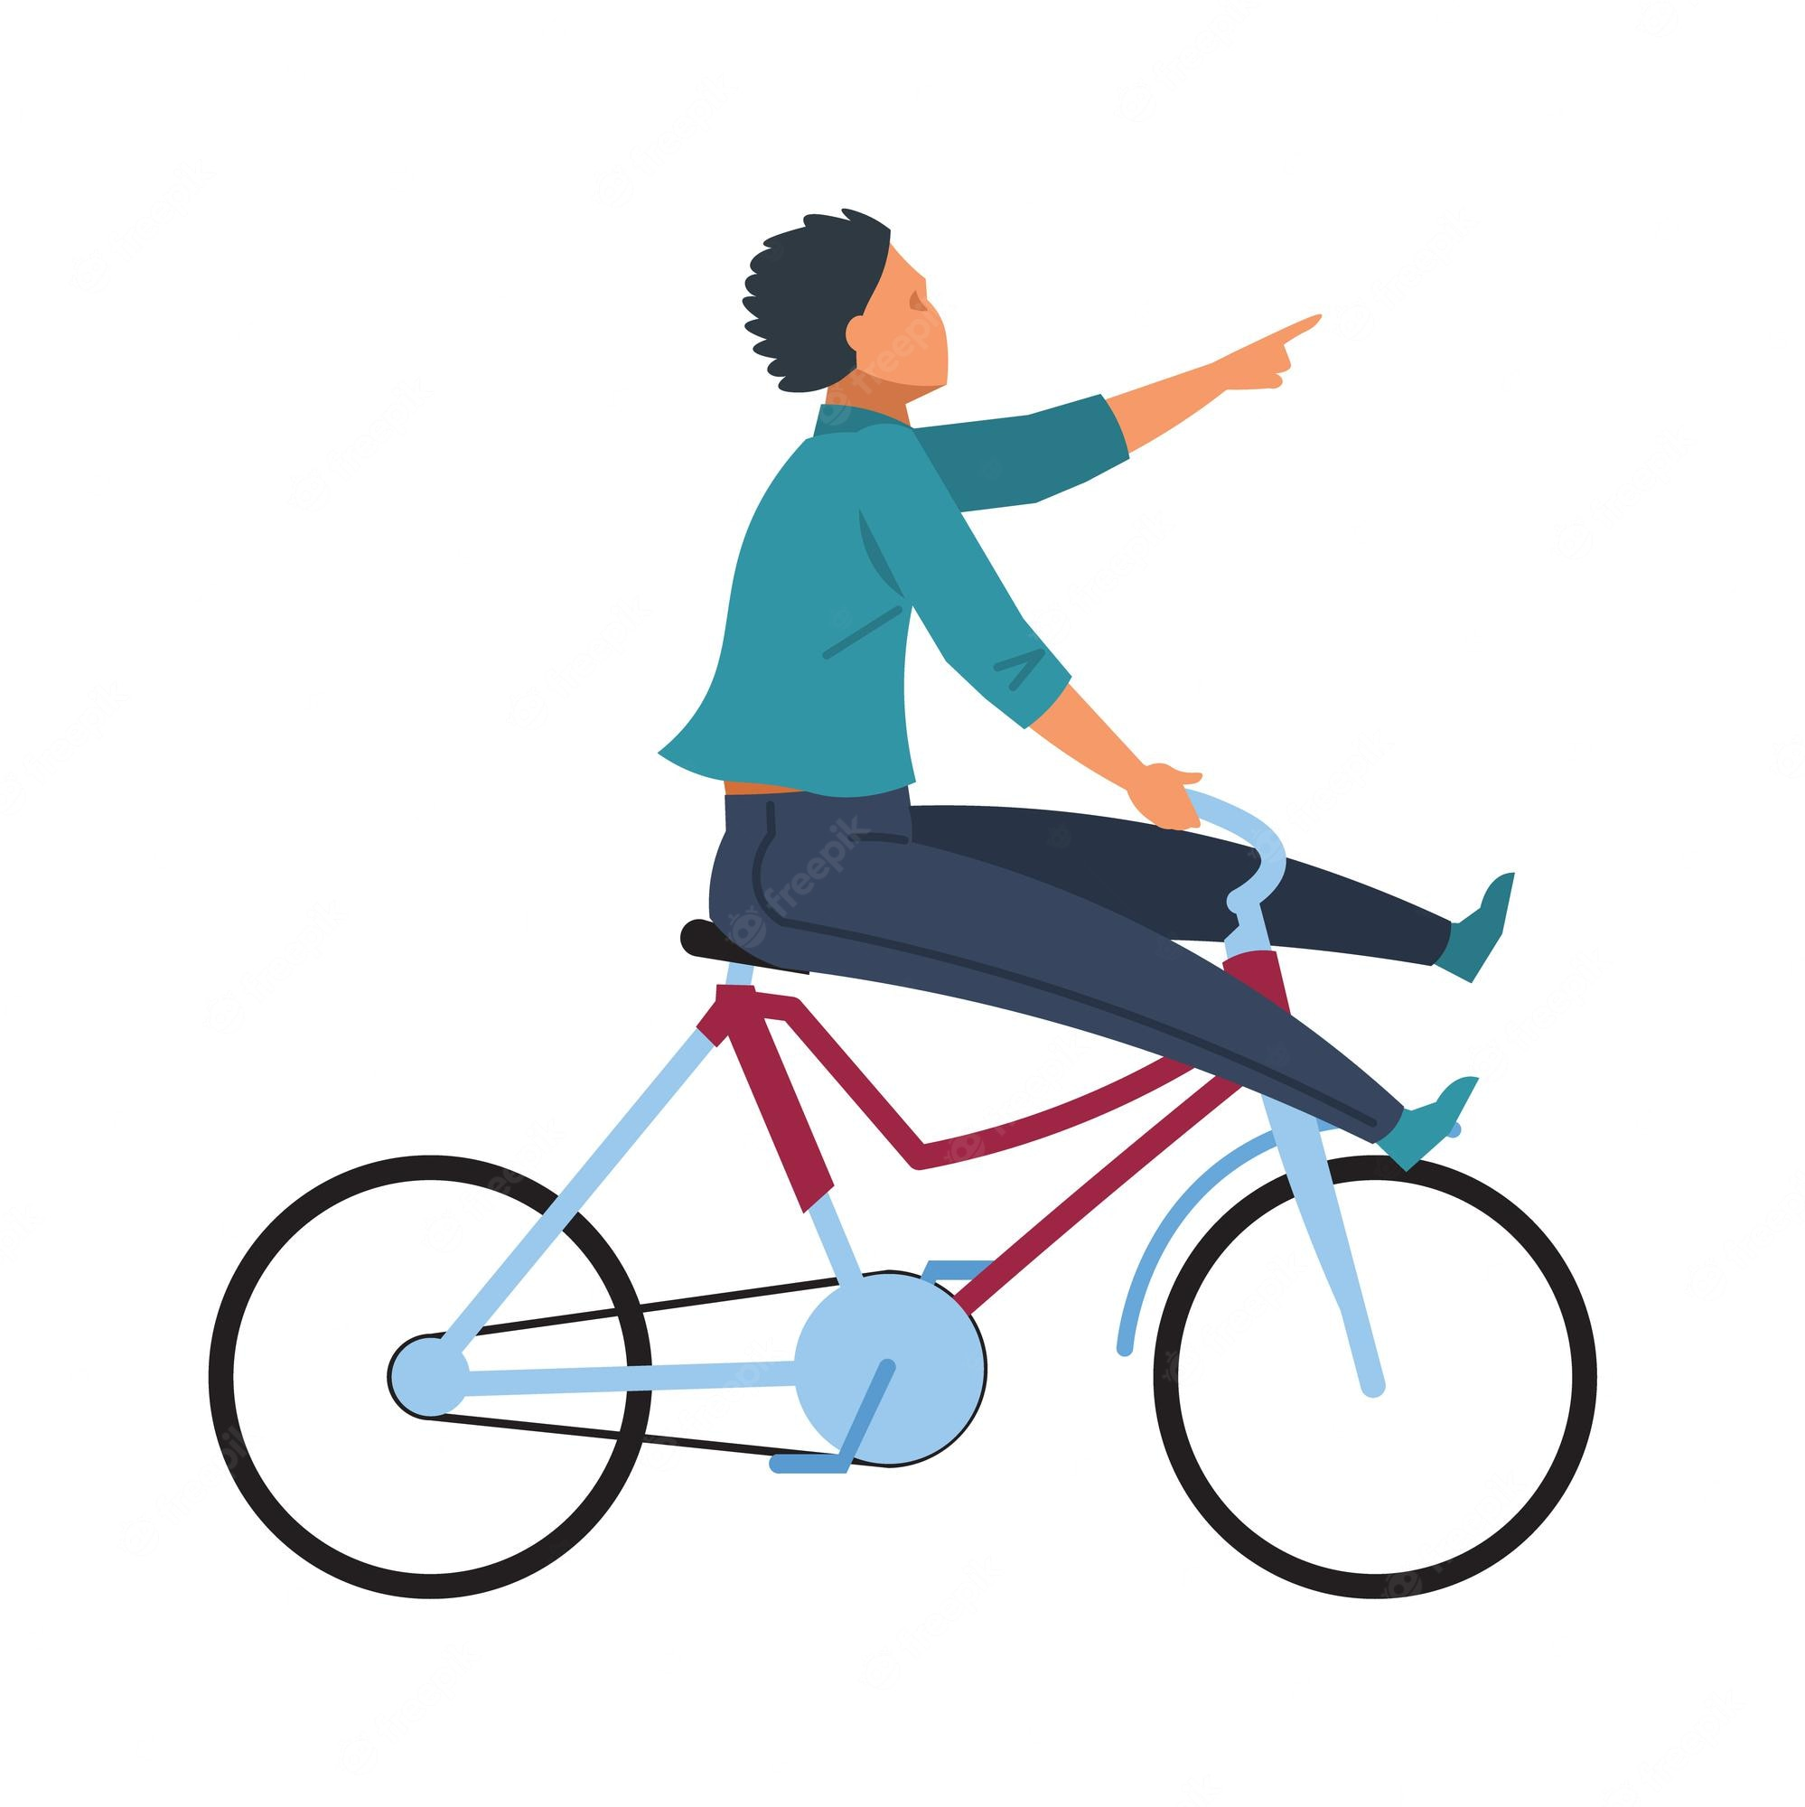
Why Idea -1
This design contains all the solutions for the described problems in define phase
Unique features it has
Magnetic charger which reduces the maintenance and reduces mishandling
It has no chain but have a chainless mechanism that removes all the mishandling cases
Contains the QR code scanner to trye directly connected so can lock the cycle anywhere even though no stands present
Can directly charge through the wireless charging provided at sheds and with the solar sheets attached on cycle
Portable umbrella so can use it only when necessary

Slide 14
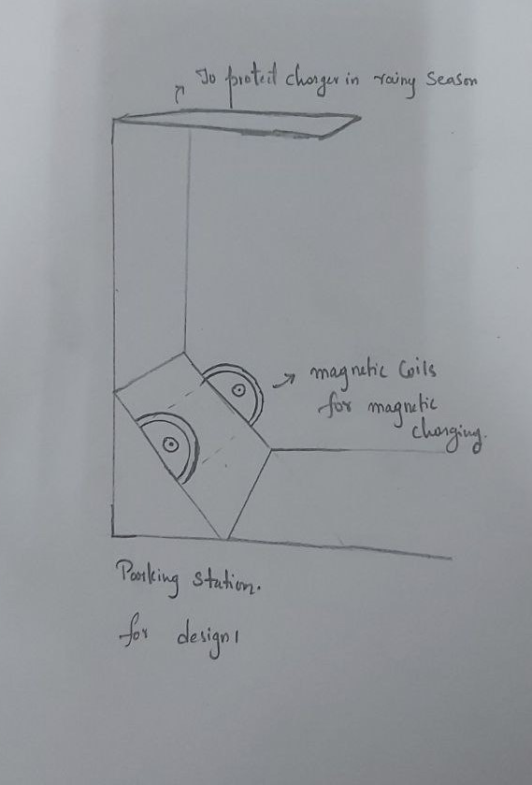
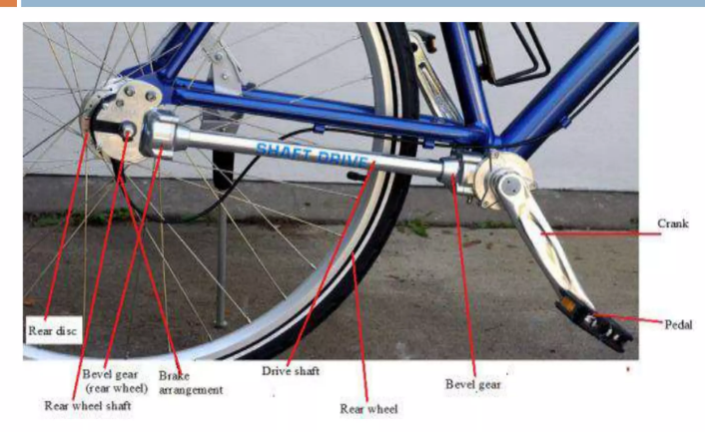
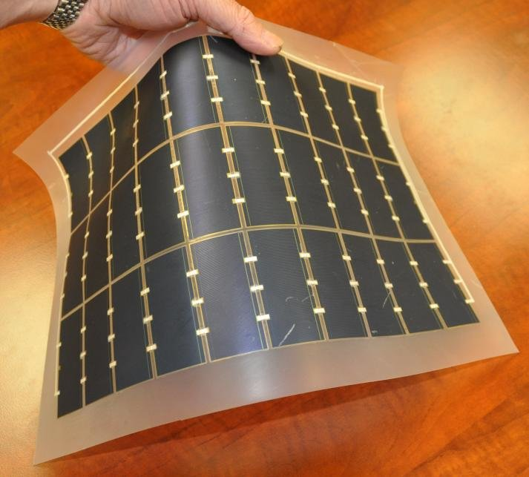
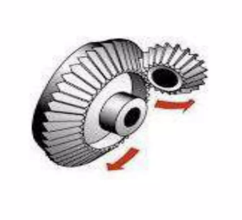
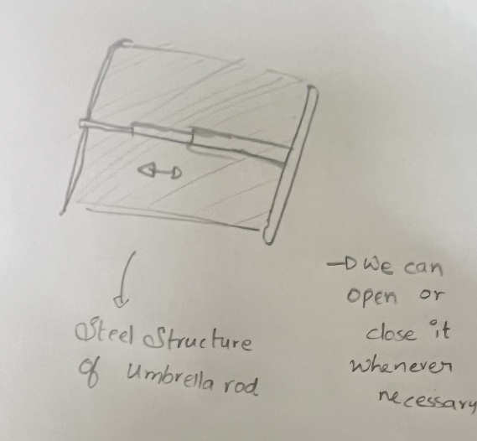

Slide 15
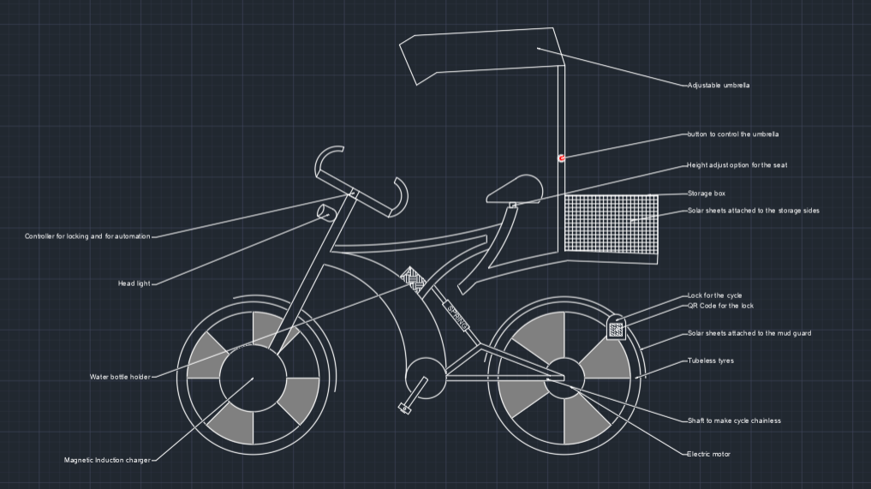

Slide 16
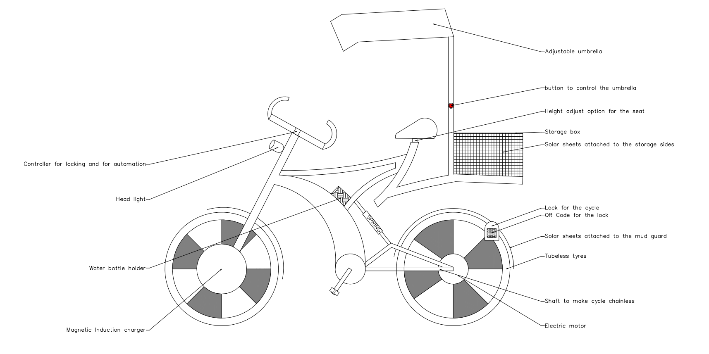

Slide 17
Thank you

Slide 18

The back locks in remaining designs are
The idea 2 has back locks
The cycle requires more human Power to maintain
The charging cables are difficult to maintain and more chance of mishandling
The idea 3 back locks
There batteries are difficult to maintain there is a heavy chance of getting spoiled quickly
Due to heavy motor weight ,it is difficult to balance
The idea 4 has back locks
The cycle requires human power to maintain
Balancing is difficult for tall people
The idea 5 back locks
The cycle requires human power to maintain
The balance and cycle design of the cycle should be improved
It doesn’t Solves all the security issues

